Slide 1
CPE 404
Computer Hardware Design
Dr Osama Hosameldeen
Spring 2021
Lecture 6
Sequential Circuits – Flip Flops

Slide 2
Topics
Sequential Circuit Definitions
  Latches
  Flip-Flops
Delays in Sequential Circuits
Clock Gating
Notes:
School of Engineering

Slide 3
Combinational Circuits vs.
Sequential Circuits

Slide 4
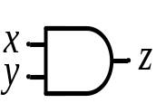
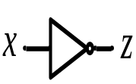
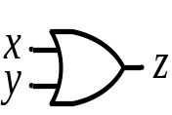
Combinational Circuits
A combinational logic circuit has:
  A set of m inputs,
  A set of n outputs, and
  The output depends only on the current input values
  No States, no Feedback, no cycles
A block diagram:
Combinatorial
Logic
Circuit
m Inputs
n Outputs
Notes:
School of Engineering

Slide 5
Combinational vs. Sequential Circuits
Combinational logic are very interesting and useful for designing arithmetic circuits (adders, multipliers) or in other words the Data Path of a computer.
  Combinational circuits cannot remember what happened in the past (i.e. outputs are a function of current inputs).
In certain cases we might need to store some info before we proceed with our computation or take action based on a certain state that happened in the past.
  Sequential circuits are capable of storing information between operations. They are useful in designing registers, counters, and Control Circuits.

Slide 6
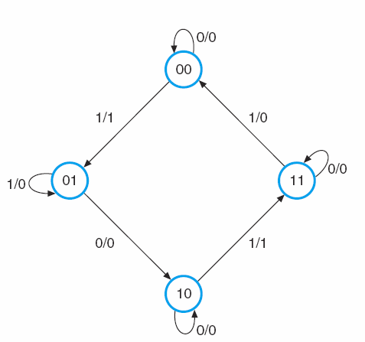
Remembering States
Counters:
  you start with count 0 and then proceed with count 1 and then to count 2 …
  The counter is an example of a sequential circuit that needs to remember the previous state in order for it go to the correct new state.
  The output of the counter is based on the current state and also the inputs.
ATM Machine:
  You insert your card (state 0)
  The system will then go to (state 1) that will ask you to enter your pin number
  If successful then the machine will go to (state 2) that will ask you for the service required (withdraw cash, determine the balance, …)
  The ATM machine is yet another example of a sequential machine that will give the correct response (output) based on your input and also on the current state.
Control of Appliances:
  The control unit of a washing machine is an example of a sequential machine.
  It starts with an initial state (does nothing!!)
  It will wait for some input from the user (setting the dials to perform a certain task).
  Based on the input and current state it will move from one state to another (wash, then rinse then spin …)
Input/Output
State Diagram
Notes:
School of Engineering

Slide 7
Sequential Circuits

Slide 8
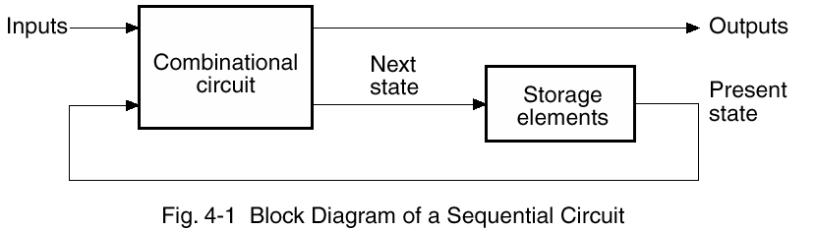
Storage Elements
Information that is stored in the storage elements represent the state of the system.
The outputs will depend on the:
  Inputs and
  Present state of the storage elements.
Storage
Elements

Slide 9
Types of Sequential Circuits
Two main types and their classification depends on the times at which their inputs are observed and their internal state changes.
  Synchronous
    State changes synchronized by one or more clocks
    The system is driven by a global clock.
  Asynchronous
    Changes occur independently

Slide 10
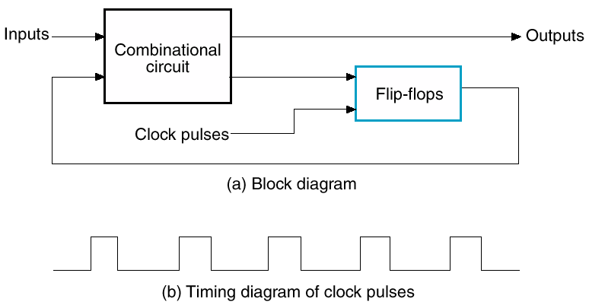
Clocking of Synchronous Circuits
Changes enabled by a Global Clock

Slide 11
Latches

Slide 12
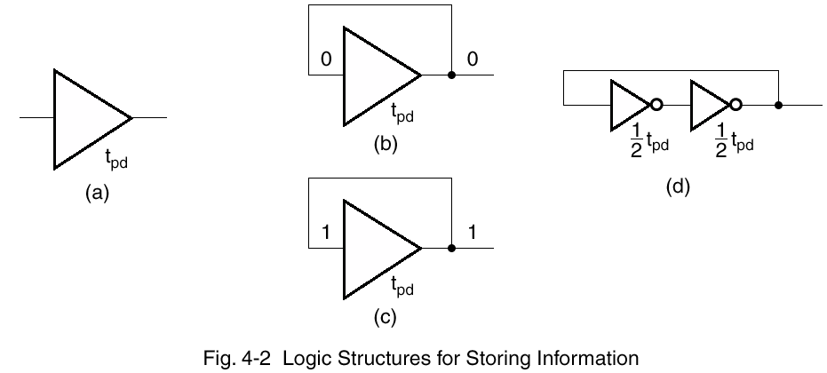
Basic Storage (How?)
Apply low or high for longer than t_{pd}
  But we are interested in storing information indefinitely!
Feedback will hold value
  However we want inputs to our circuitry!

Slide 13
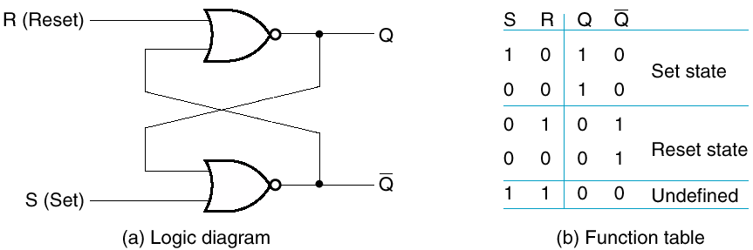
SR (Set-Reset) Latches:
Replace the inverters with NAND, NOR Gates
Basic storage made from gates
The information can be changed
1
0
0
1
1
0
S & R both 0 in “resting” state
Avoid both from being 1 at same time

Slide 14
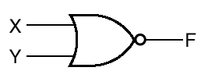
Explaining Set Case
X Y Z
0 0
0 1
0
1 1
1
0
0
0
0
1
0
1

Slide 15
Latches
Latches are storage elements that can maintain a binary state indefinitely (as long as power is delivered to the circuit) until directed by an input signal to switch states.
  Latches are asynchronous circuits
  Latches are used to build more complex synchronous circuits such as Flip Flops.

Slide 16
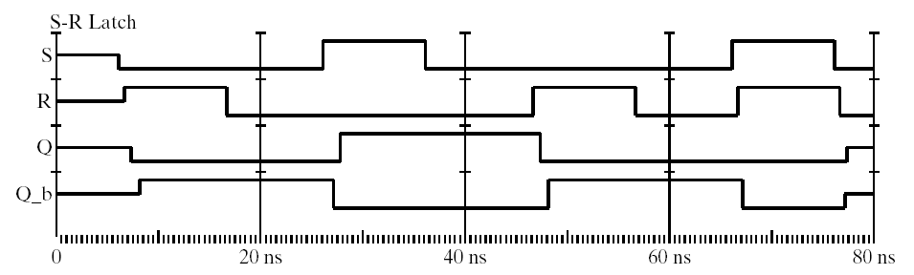
Operation
Reset, Q=0
Set, Q=1
Undefined!
Keep State

Slide 17

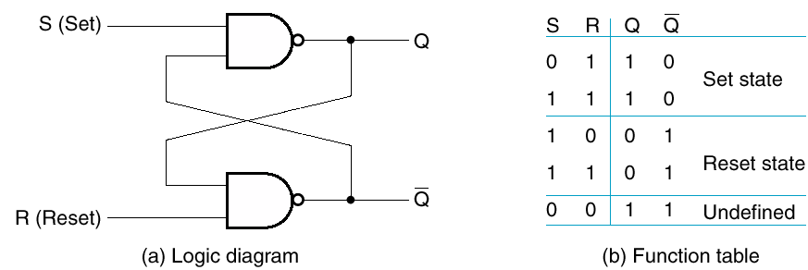
Latch
Similar – made from NANDs
0
1
0
1
S & R both 1 in “resting” state
Avoid setting both to 0 at same time

Slide 18
Latch + Control

Slide 19
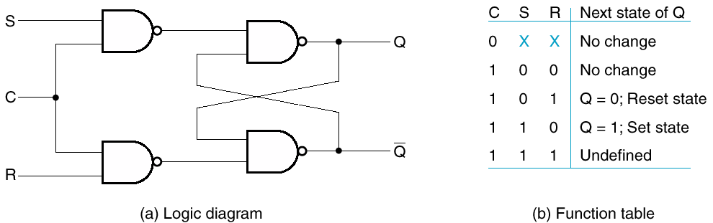
Add Control Input: SR Latch
An additional input determines when the state of the latch can be changed!
1
1
Can we avoid the undefined state?

Slide 20
Add Control Input: SR Latch
Redundant
Solution: Connect S, R such that they never get same value!!

Slide 21
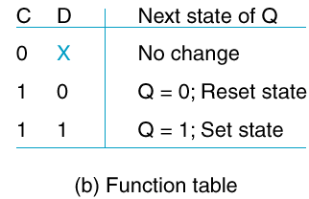
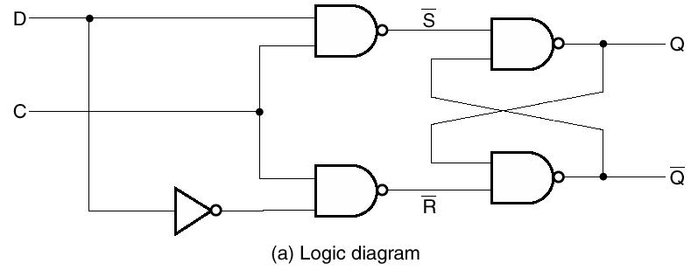
D-type Latch
No illegal state
1
0

Slide 22
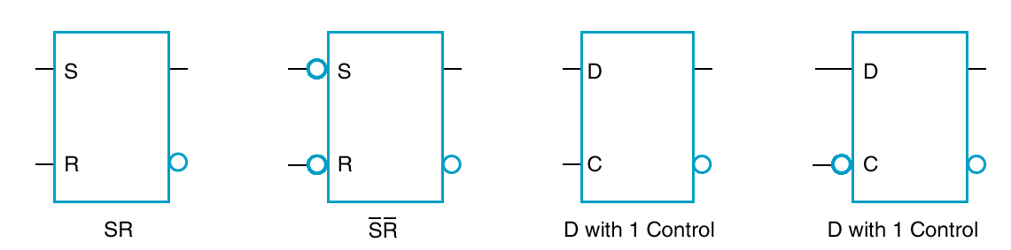
Standard Symbols – Latches
Circle at input indicates negation

Slide 23
Issues with Latches

Slide 24
Transparency of Latches
The state of a latch is allowed to switch by a momentary change in value on the control input.
  As long as C (the trigger ) is high, state can change!
This is called transparency
What is wrong with transparency?

Slide 25
Effects of Transparency
Storage
Element
Clock
Output of one latch may feedback
  As soon as the input changes, shortly thereafter the corresponding output changes to match it.
  The final state will depend on how long the clock pulse stays at level logic 1! (unreliable)
  We need to predict the outputs at a certain moment in time!
Want to change latch state once
  Depending on inputs at time of clock

Slide 26
Flip Flops

Slide 27
Flip-Flops
Ensure only one transition
Two major types
  Master-Slave (level triggered)
    Two stage
    Output not changed until clock disabled
  Edge triggered
    Change happens when clock level changes

Slide 28
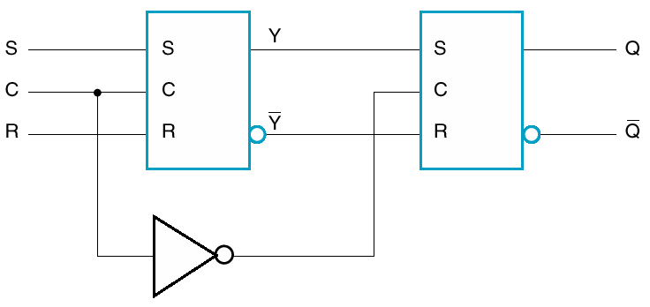
Master-Slave SR Flip-Flop
When Master is enabled, Slave is disabled!
Output Q will not change when inputs change
S
C
R
S
C
R
S
C
R
SR Latch
Master
Slave

Slide 29
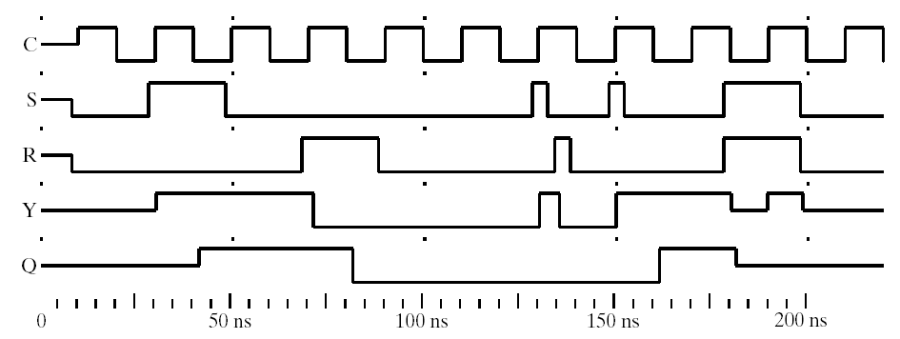
Timing Diagram
Trace the behavior
Is it transparent?
1
1
0
0

Slide 30
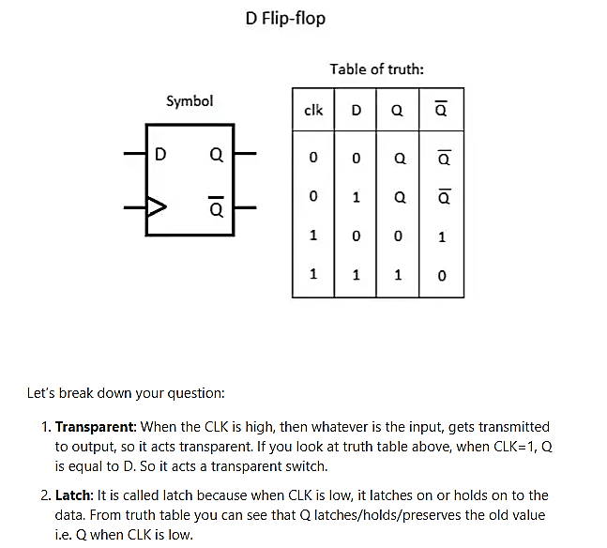
Have We Fixed the Problem?
Output no longer transparent
  Combinational circuit can use last values
  New inputs appear at latches
  Not sent to output until clock low
  In one clock cycle we can predict what will happen

Slide 31
Have We Fixed the Problem?
Output no longer transparent
  Combinational circuit can use last values
Low
Master/Slave FF
Latch Transparent

Slide 32
JK Flip Flops

Slide 33
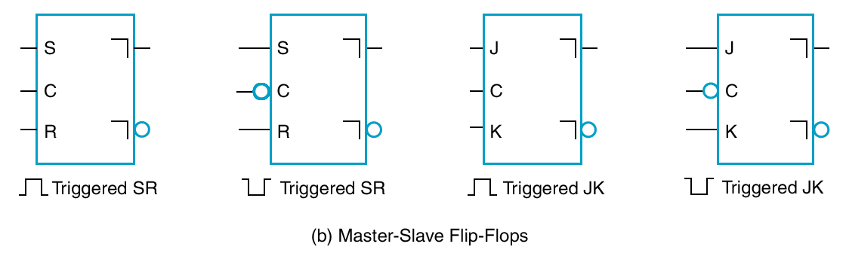
JK Flip Flop
The JK Flip Flop is a modified version of the SR Flip Flop.
The JK flip flop performs three operations:
  Set Q to 1
  reset Q to 0
  complement the output

Slide 34
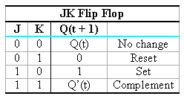
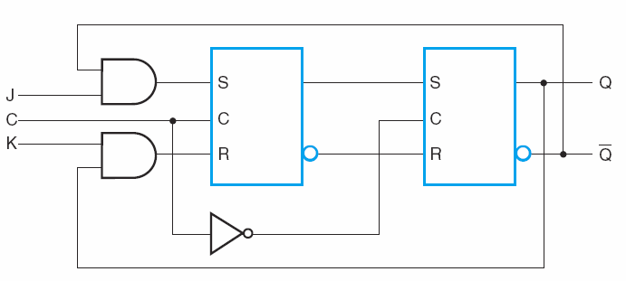
Master-Slave JK Flip Flop
  The J input sets the flip flop to 1.
  The K input resets the flip flop to 0.
  When both J and K are enabled, the output is complemented.
  When both J and K are 0 → No Change

Slide 35
Symbols – Master-Slave
Inverted L indicates postponed output
Circle indicates whether enable is positive or negative

Slide 36
Edge-Triggered Flip-Flops
An Edge Triggered Flip-Flop ignores the pulse while it is at a constant level and triggers only during a transition of the clock signal.
  New state latched on clock transition
  Low-to-high (positive edge triggered),
  High-to-low (negative edge triggered)
Changes when clock high are ignored

Slide 37
JK Characteristic Tables
Define the logical properties of a flip flop by describing its operations in tabular form.
  They define the next state as a function of the inputs and the present state.
  Q(t) refers to the present state prior to the application of a clock edge.
  Q(t + 1) refers to the next state one clock period later.
  Clock edges are not listed as inputs but are implied by the transition from t to t + 1.

Slide 38
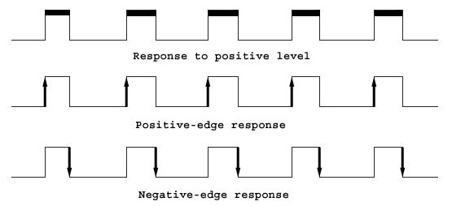
Clock Responses
We can classify Flip/Flops according to the response to the clock.

Slide 39
D Flip Flops

Slide 40
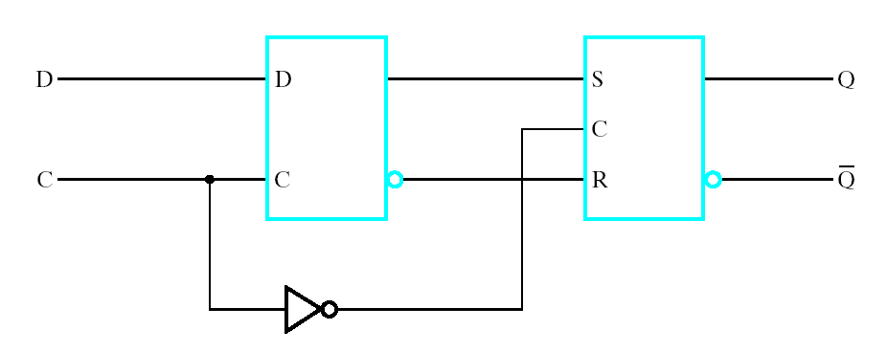
Edge Triggered D-Flip-Flop
D Latch
D
C
S
C
R
SR Latch

Slide 41
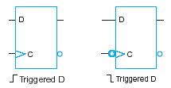
Edge-Triggered D Flip Flop: Graphic Symbols
The triangle is called: dynamic indicator

Slide 42

D FF Characteristic Table
The Characteristic Equation:
Q(t + 1) = D(t)
This indicates that the output (next state)
always follows the input!!

Slide 43
Other Flip Flops
Other types of flip flops can be constructed by using the D flip flop and external logic.
The two most commonly used are:
  Edge triggered JK flip flops
  T flip flops

Slide 44
Characteristic Tables

Slide 45
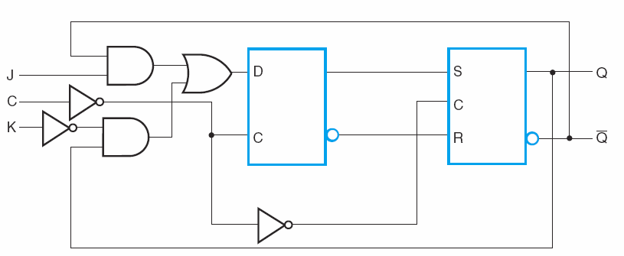
Edge-Triggered JK Flip Flop
Characteristic Equation:
Q(t+1) = J(t) Q’(t) + K’(t)Q(t)

Slide 46
JK Characteristic Table
Characteristic Equation:
Q(t+1) = J(t) Q’(t) + K’(t)Q(t)
How to derive the characteristic equation of the JK FlipFlop?
Notes:
The characteristic equation of the JK Flip Flop is derived as following (Get Truth Table, Map to K-Map)
J K Q CLK | Q+
--------------------------
0 0 0 ^ | 0
0 0 1 ^ | 1
--------------------------
0 1 0 ^ | 0
0 1 1 ^ | 0
--------------------------
0 0 ^ | 1
1 0 1 ^ | 1
--------------------------
1 1 0 ^ | 1
1 1 ^ | 0
--------------------------
X X Q 0 | Q
X X Q 1 | Q
School of Engineering

Slide 47
JK- Characteristic Equation
J | K | Q | CLK | Q+
0 | 0 | 0 | ^ | 0
0 | 0 | 1 | ^ | 1
0 | 1 | 0 | ^ | 0
0 | 1 | 1 | ^ | 0
1 | 0 | 0 | ^ | 1
1 | 0 | 1 | ^ | 1
1 | 1 | 0 | ^ | 1
1 | 1 | 1 | ^ | 0
JK
Q
00
01
11
10
0
0 | 0 | 1 | 1
1 | 0 | 0 | 1
1
Q(t+1) = J(t) Q’(t) + K’(t)Q(t)

Slide 48
T-Flipflop

Slide 49

T Flip Flop
The T Flip Flop is a complementing flip flop.
How can we obtain a T Flip Flop from a JK Flip Flop or D Flip Flop?
T
Q(t+1) = TQ’(t) + T’Q(t)

Slide 50

T Flip Flop
The T flip flop can be obtained from a JK flip flop when inputs J and K are tied together.

Slide 51
Summary:
Characteristic Equations

Slide 52
Characteristic Equations
The D flip flop can be expressed as:
  Q(t + 1) = D
The JK flip flop can be expressed as:
  Q(t + 1) = JQ’ + K’Q
The T flip flop can be expressed as:
  Q(t + 1) = TQ’ + T’Q
Characteristic Tables are used to
  Derive the characteristic equations,
  Analyze Sequential Circuits.

Slide 53
Set/Reset Inputs

Slide 54
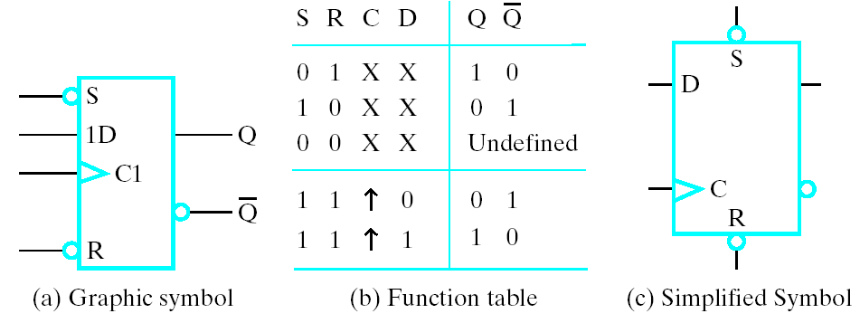
Direct Inputs
Set/Reset independent of clock (Active Low)
  Direct set or preset
  Direct reset or clear
Often used for power-up reset

Slide 55
Timing

Slide 56
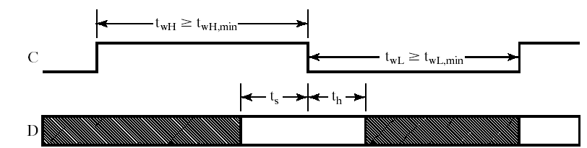
Timing
Setup time (t_{s})– time that input must be available (stable) before clock edge
Hold time (t_{h})– time that input must be stable after clock edge

Slide 57
Lecture End

